Slide 1
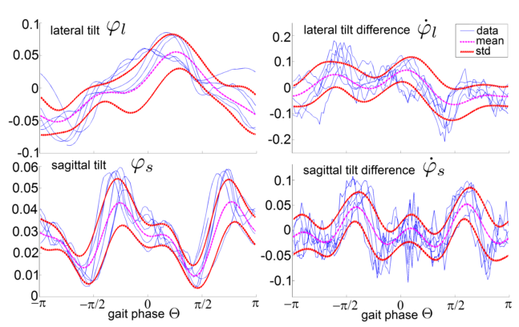
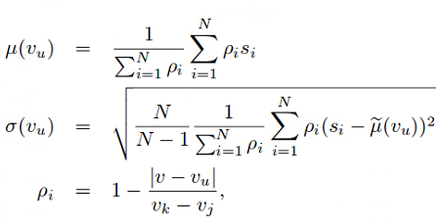
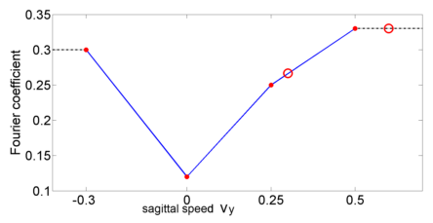

Literature Review on Fall Detection
Instability Detection and Fall Avoidance for a Humanoid using Attitude Sensors and Reflexes (Renner 2006)
Offline model based abnormality evaluation approach
For a database of support gaits, the periodic trajectories of the robot roll and pitch are recorded. A Fourier transform is conducted to compute the Fourier coefficients of the low frequency components.
Then for another walking gait, a linear interpolation is conducted to get the Fourier coefficient. The corresponding mean and standard deviation is calculated to provide the normalized standard deviation.

Slide 2
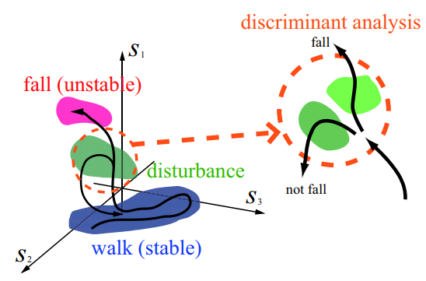
Literature Review on Fall Detection
Falling Motion Control for Humanoid Robots While Walking (Ogata 2007)
Two fall detection approach have been proposed.
Method 1: Abnormality detection method with heuristic threshold
For certain “Normal” gait, a statistic average gait is calculate from many gait data. During its period, taking an evenly distributed N data as references. Then compare the actual robot state at the matching time to these references.
Method 2:
An categorization of the disturbed state is studied. There are two kinds of disturbed states: unstabilizable or stabilizable. Then a discriminant analysis is conducted to learn the data in order to classify the type of the unstable states.

Slide 3
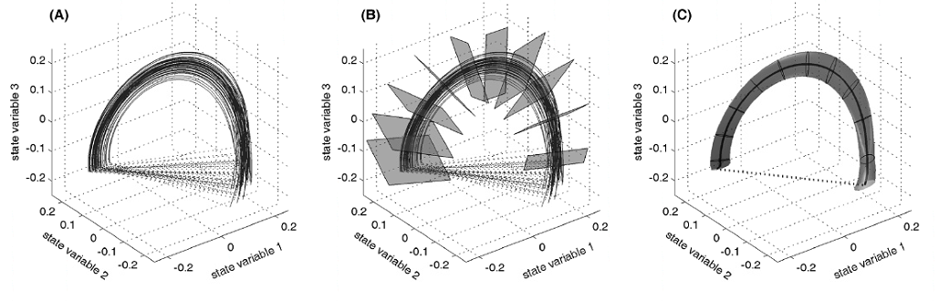
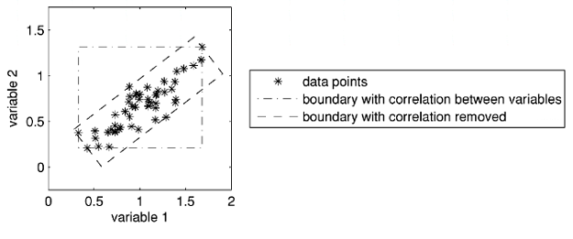





Literature Review on Fall Detection
Fall detection in walking robots by multi-way principal component analysis (Karssen 2008)
Offline model based abnormality evaluation approach
For I points on (J-1)-dimensional plane, select K slices. On each slice, for all I points, data points on each dimension are analyzed through the PCA approach.
Then normal distributions for each dimension are computed.
Cost is defined with the D-statistic for each slice. A heuristic value is then chosen for stability evaluation.

Slide 4
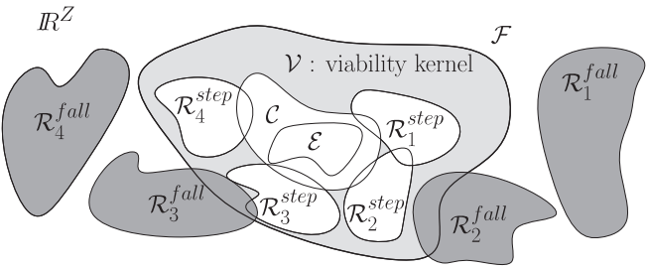
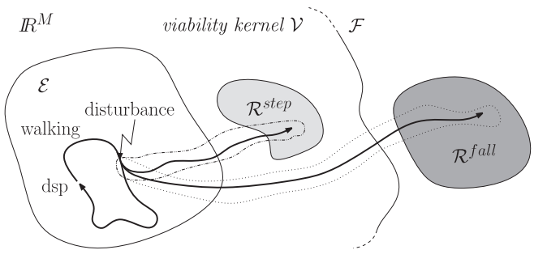




Literature Review on Fall Detection
Probabilistic Balance Monitoring for Bipedal Robots (Hohn 2009)
Offline model based probability evaluation method
Instead of a comparison using the robot state vector, the method proposes a sensor-based feature measurement for comparison. Features contain force sensors, robot roll/pitch angle and angular velocities, MicroIMU at feet.
GMM: single time sample comparison
HMM: sample duration sequence comparison – kernel transition sequence to determine the set of the final robot state

Slide 5
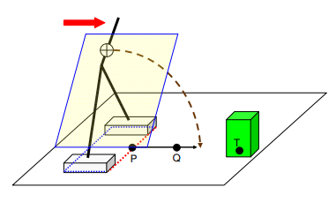
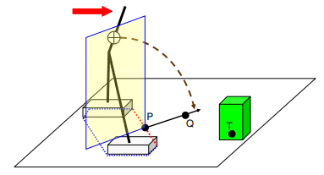
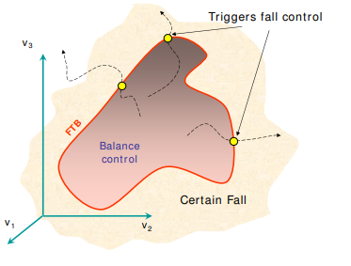
Literature Review on Fall Detection
Safe Fall: Humanoid robot fall direction change through intelligent stepping and inertia shaping (Yun 2009)
ZMP/COP with respect to the support polygon

Slide 6
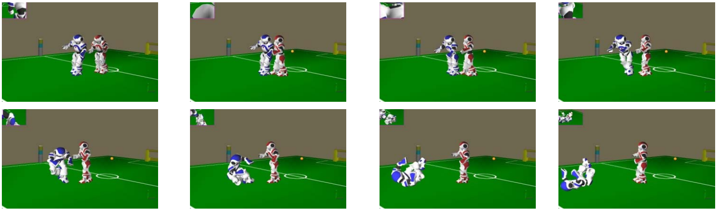
Literature Review on Fall Detection
Fall Detection and Management in Biped Humanoid Robots (Ruiz-del-Solar 2010)
Online heuristic comparison approach: A comparison between the body’s roll/pitch angle and angular velocities with respect to some heuristic thresholds.
Body’s roll/pitch angle and angular velocities are accessible through a Kalman filtered sensor data.

Slide 7
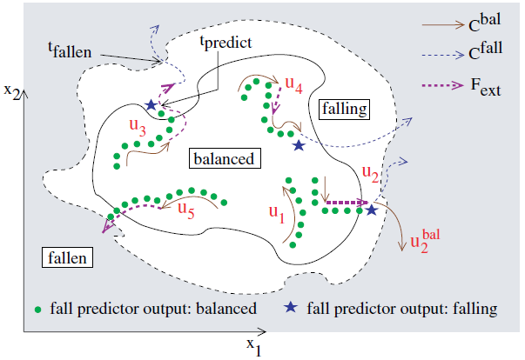
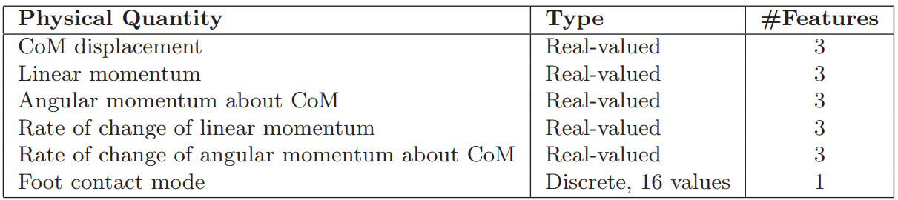
Literature Review on Fall Detection
Learning to Predict Humanoid Fall (Kalyanakrishnan 2011)
Supervised learning approach as the fall indicator to classify the robot state
Training is conducted in the simulation software. Training trajectories are gathered by imposing impulse to the representative robot configuration in different contact states.

Slide 8
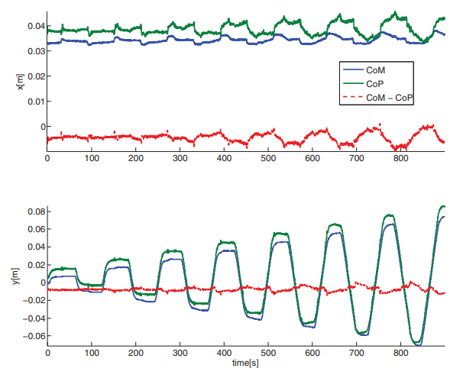


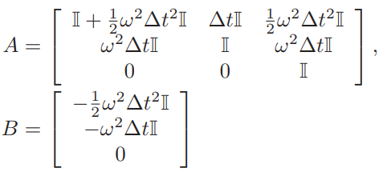

Literature Review on Fall Detection
Center of Mass Estimator for Humanoids and its Application in Modelling Error Compensation, Fall Detection and Prevention (Xinjilefu 2015)
An COM estimation correction with an offset value by Kalman filter algorithm.
Comparison of Capture Point within the Support Polygon for the fall indicator.
Upper and Low bounds of force/torque sensor to determine the support polygon.

Slide 9
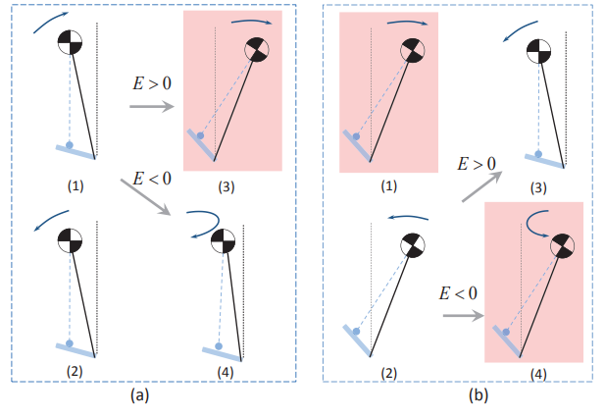
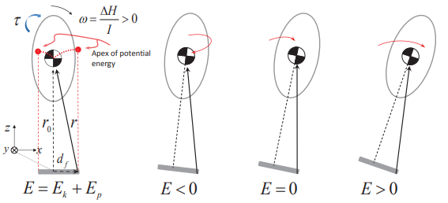
Literature Review on Fall Detection
Fall Prediction of Legged Robots Based on Energy State and Its Implication of Balance Augmentation: A Study on the Humanoid (Li 2015)
Inverted Pendulum Orbital Energy as the fall indicator
Our previous work (ICRA 2018) coincidentally shares the same idea with this method.

Slide 10
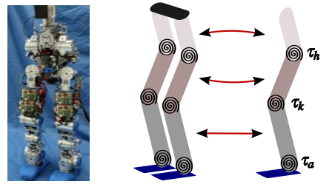
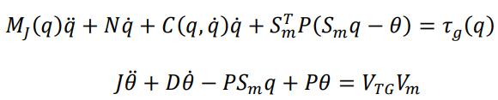
Literature Review on Fall Detection
Lyapunov Stability Margins for Humanoid Robot Balancing (Tsagarakis 2016)
Model-based Lyapunov function to monitor the robot motion stability
In addition to a simplified robot model, the motor dynamics is also considered in the formulation of the Lyapunov function.
Energy threshold can be chosen heuristically to determine the stability status of the given robot state.

